Slide 1
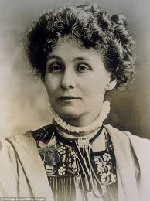
Emmeline Pankhurst
Emmeline Pankhurst was born in Manchester,
in the north of England, in 1858. Back then British women couldn’t vote in elections, but men could.

Slide 2
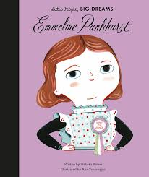
School in Paris
Emmeline went to school in Paris, France. As she grew up she became interested in politics and wanted to create a more equal society for women and men. She wanted women to have the same rights as men, such as the right to an education, the right to have a good job and, perhaps most importantly, the right to vote.

Slide 3
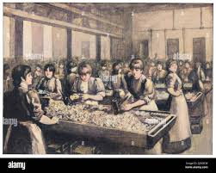
The Bryant and May match factory
In 1888, the girls who worked at the Bryant and May match factory in London went on strike. They stopped working and asked the owner of the factory to improve their terrible working conditions. They worked 14 hours a day and were fined for dropping matches on the floor. Many of the girls were ill because they worked with dangerous chemicals. Emmeline supported the strike.

Slide 4
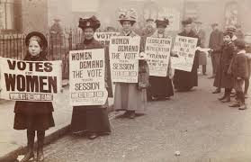
The Suffragettes
Emmeline formed The Women's Social and Political Union, also called the Suffragettes, in 1903. The Suffragettes were a group who fought for women’s rights, especially the right to vote. They published a newspaper called Votes for Women which sold 20,000 copies a week.

Slide 5
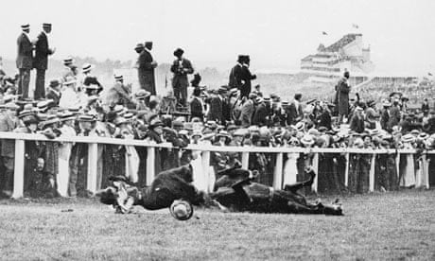
Emily Davison
The Suffragettes also held demonstrations, and they often broke the law by smashing windows or chaining themselves to fences to protest. In 1913, a Suffragette called Emily Davison was killed when she threw herself under the king's horse at a famous horse race, as a protest because the government refused to give women the right to vote.

Slide 6
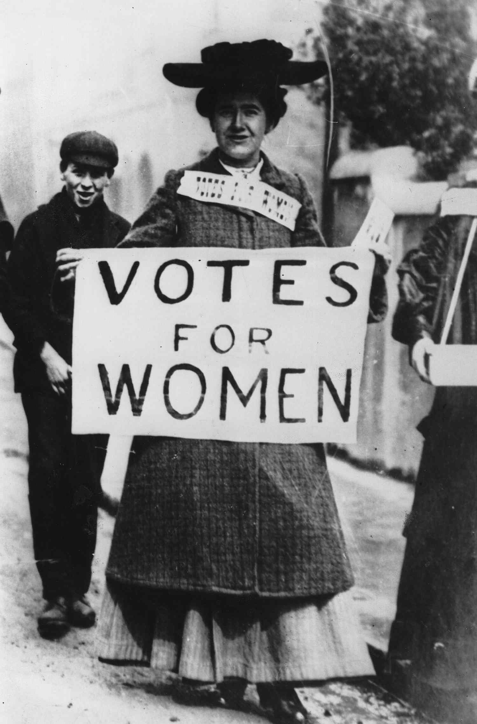
VOTES FOR WOMEN
In 1918, the British government gave women aged over 30 the right to vote, although men could vote when they were 21. Women were finally allowed to vote at the same age as men shortly after Emmeline died on 14 June 1928. Emmeline Pankhurst is sometimes described as one of the most influential people of the 20th century.

Slide 7
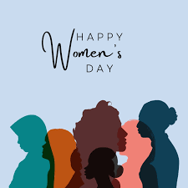
Edgar abgaryan, the 6th grader mskh.am
HAPPY WOMEN’S DAY

